Slide 1
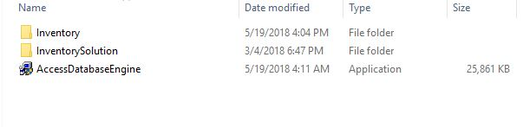
Guide to Your Space
Greetings, Welcome to the application. This is the guide to install and run the application.
Before starting here are some basic requirements for the application.
Your system must contain Microsoft Office 2007. If you don’t have the application you have to Run the
application “AccessDatabaseEngine” provided in the attachment.
This will be the first screen you will be seeing. As mentioned in the Requirements if you don’t have Microsoft office 2007 you will be getting an error while you are opening the application. In that case please click on AccessDatabaseEngine.

Slide 2
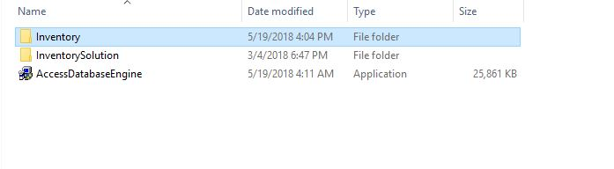
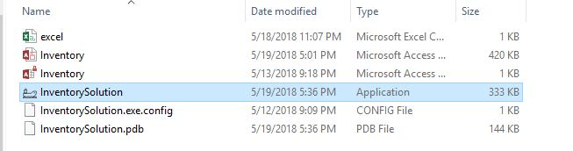
Now click on the Inventory
Click on the Ship icon to start the application.

Slide 3
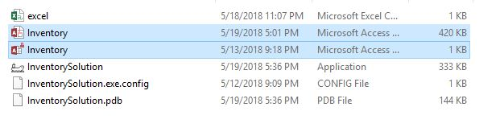
You need to maintain these two files. It’s important for the function of the application.

Slide 4
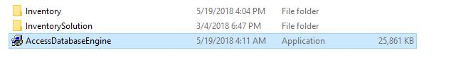
The setup process of AccessDatabaseEngine can be done easily.
Specifications used for developing the application:
1. Visual Basic Studio
2. Language used : C#, .NET.
3. Operating System used for Development: Microsoft Windows 2007
4. Database Storage Location : Microsoft Access 2007
This Application is a pure system based application and developed keeping in the mind of the future usage.

Slide 5
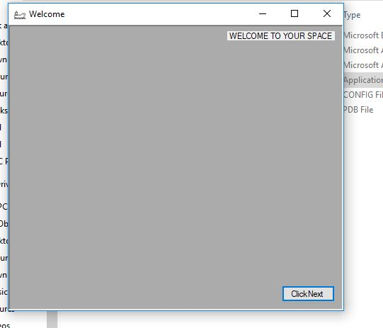
After clicking on the Application this window will be displayed.
Here Click Next to start the application to store your data.

Slide 6
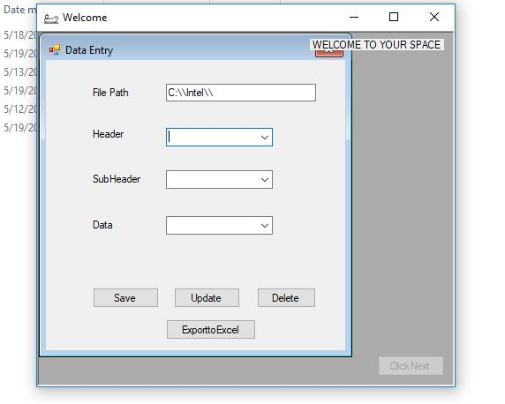
If you don’t have this file in your C drive please
create a folder by the exact name.
* File Path specifies the location your file is going to be stored.
* Header will be the Name of your file.
* Sub Header will be the Main heading of the data in which you are going to store 10 or More entries as your requirement.
*In the final Data field you can enter Multiple Entries.

Slide 7
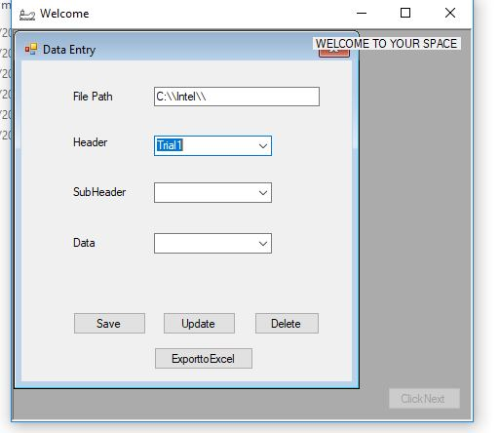
After entering the header which will be the file name of your Application
Click on Save. After entering the Header.

Slide 8
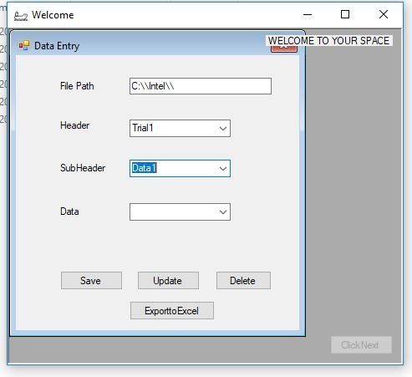
For every new data entry in the Sub Header you need to
Save it by clicking on the Save Button.
*It is mandatory to enter or select the Header for storing the data in Sub Header.

Slide 9
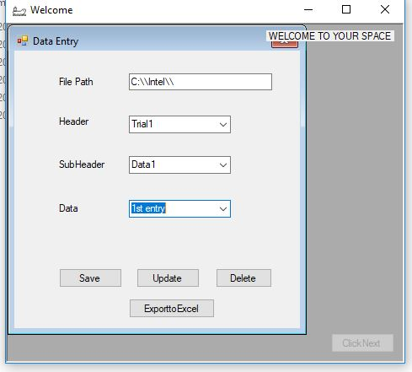
Enter the data in the Data column and click on Save.
*To enter the data in the Data field you need to enter or select the Header and Sub Header to save your new Entries.

Slide 10
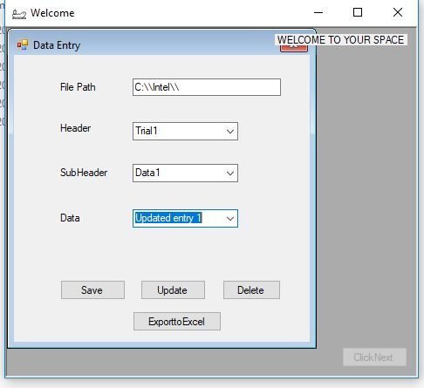
To update the Data select the entries in any of the box and click on update.
For updating the Sub header you need to select the Header in which you want to update.
For updating the Data you need to select the Header and Sub Header.

Slide 11
For deleting the Data select the data and click on delete.
*For Deleting the Sub Header and Data you need to select the Hierarchical fields.

Slide 12
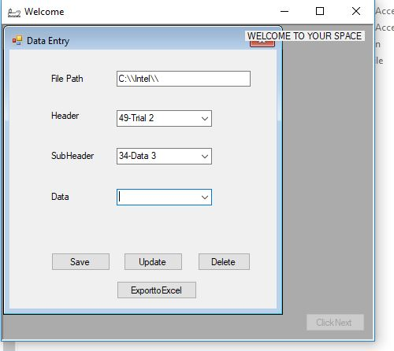
You can choose new fields by clicking on the Down
Arrow and selecting your option from
the scroll down bar.
The No. which you are noticing with the entry is a key and
It acts as a identifier and it will not be part of your
document.

Slide 13
Select the Header.
Click on Export to Excel to see the data you stored in an
Excel Sheet.

Slide 14
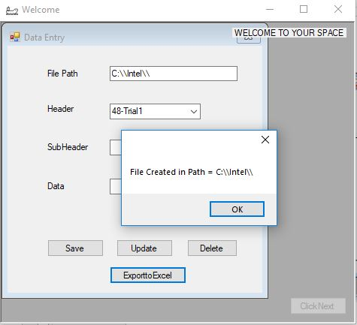
Your file will be created in the file path destination once you click on Export to excel.

Slide 15
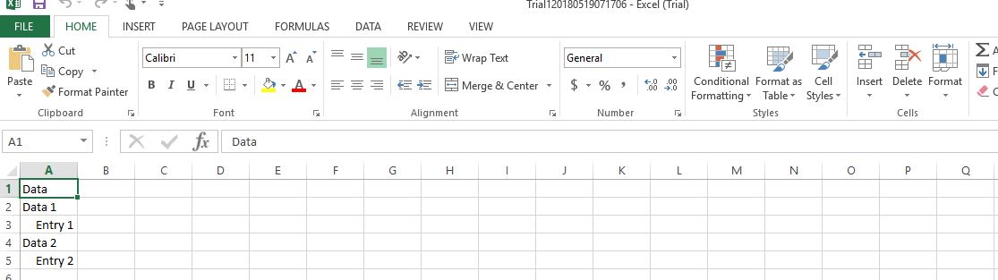
By this Excel file you can check the data which you have saved.

Slide 16
Thank You.

